Slide 1
Jaap System
Name: Omkar Kulkarni
Division: SYMCA(A)
Seat No: 4330
Project Guide-
Mr. Rahul Chaudhari

Slide 2

Introduction
.
Recognizing the importance of spiritual practices in maintaining mental well-being, the Jaap Counter System provides a digital platform for users to engage in the ancient practice of chanting mantras. Rooted in Hindu traditions, jaap refers to the repetition of a specific mantra or prayer, believed to have profound spiritual benefits. This project harnesses the power of technology to facilitate and enhance the spiritual journey of users, offering them a structured way to track and engage in their chosen mantra practice.

Slide 3
Existing System
.
The existing system is very tedious as it involves the manual data storage. Also maintaining the customer records through files and books is tedious job.
It is tedious to manage historical data which needs much space to keep all the previous year data.
Monthly counts details must be entered into books are very difficult to maintain.
It is difficult to maintain important information in books.

Slide 4
Need Of System
Simplify Tracking: A digital platform simplifies the process of recording and tracking jaaps, eliminating the need for pen and paper and reducing the potential for errors.
Improve Accessibility: Users can access their jaap records anytime and anywhere, providing greater flexibility and convenience.
Enhance Accountability: By allowing Members to subscribe to jaaps and view progress, the system encourages regular practice and accountability.
Maintain Historical Data: The system ensures that historical data is recorded and easily retrievable, enabling users to inspect their spiritual journey and progress in time.
Foster Community Engagement: Community features such as commenting and sharing progress allow users to connect with others, fostering a sense of community.
.

Slide 5
Proposed System
Member Registration and Authentication: Member can create accounts on the platform securely and authenticate themselves to access the system's features.
Jaap Creation and Customization: Users have the flexibility to create personalized jaaps, specifying the mantra, start date, end date, and any additional details relevant to their spiritual practice.
Jaap Subscription and Management: Member can browse and subscribe to existing jaaps created by User, enabling them to participate in communal spiritual practices and receive updates on their progress.
Jaap Count Tracking and Editing: The system allows Members to enter their jaap counts for subscribed jaaps on a monthly basis, with options to edit or update counts as needed.
Admin Panel for System Management: Users have access to a dedicated admin panel for managing Members and Users accounts, overseeing jaap creation and moderation, and ensuring the overall integrity and security of the system
Privacy and Security Measures: The system implements robust privacy and security measures to safeguard user data and ensure confidentiality, including encryption protocols and access controls.
.

Slide 6
Objective of System
To provide users with a user-friendly and intuitive platform for engaging in spiritual practices, specifically the chanting of mantras or jaaps.
To enable users to set personal jaap goals, track their progress over time, and receive encouragement and support from a community of like-minded individuals.
To facilitate accountability and motivation by allowing users to subscribe to specific jaaps, enter monthly jaap counts, and view their total jaap counts over time.
To offer administrators the tools to manage and moderate the system effectively, ensuring a positive and enriching user experience for all participants.

Slide 7
Scope of System
User Registration and Authentication
Jaap Creation and Subscription
Jaap Count Entry and Editing
Monthly Jaap Count Reporting
Total Jaap Count Aggregation
User Profile Management
Community Engagement Features
Admin Panel for System Management and Moderation

Slide 8

Modules
User Management.
Member Management.
Search Management.
Subscription Management .
Jaap Management.
Jaap Count Management.
Community Progress Management

Slide 9
Operating environment
Hardware
RAM: Minimum 2 GB.
Disk Space: Minimum 1GB.
Processor: Pentium-2, 3, 4 and above.
Software
Operating System: Windows 7 & above.

Slide 10
Technology used
Front end: HTML, CSS and JavaScript.
Backend: PHP.
Database: MySQL.
Tools: VS code and Xampp.

Slide 11

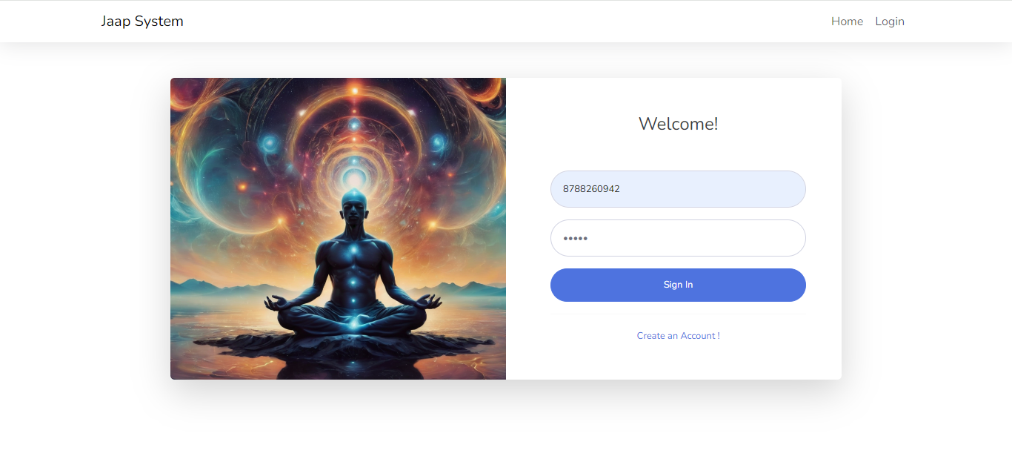
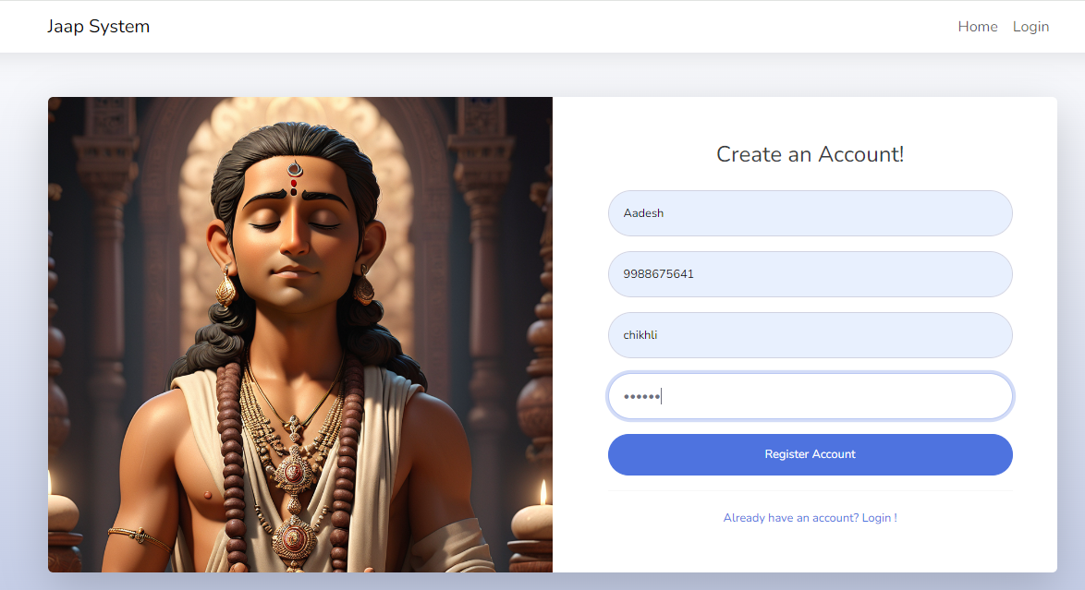
Analysis and design
Registration Page
Login Page

Slide 12
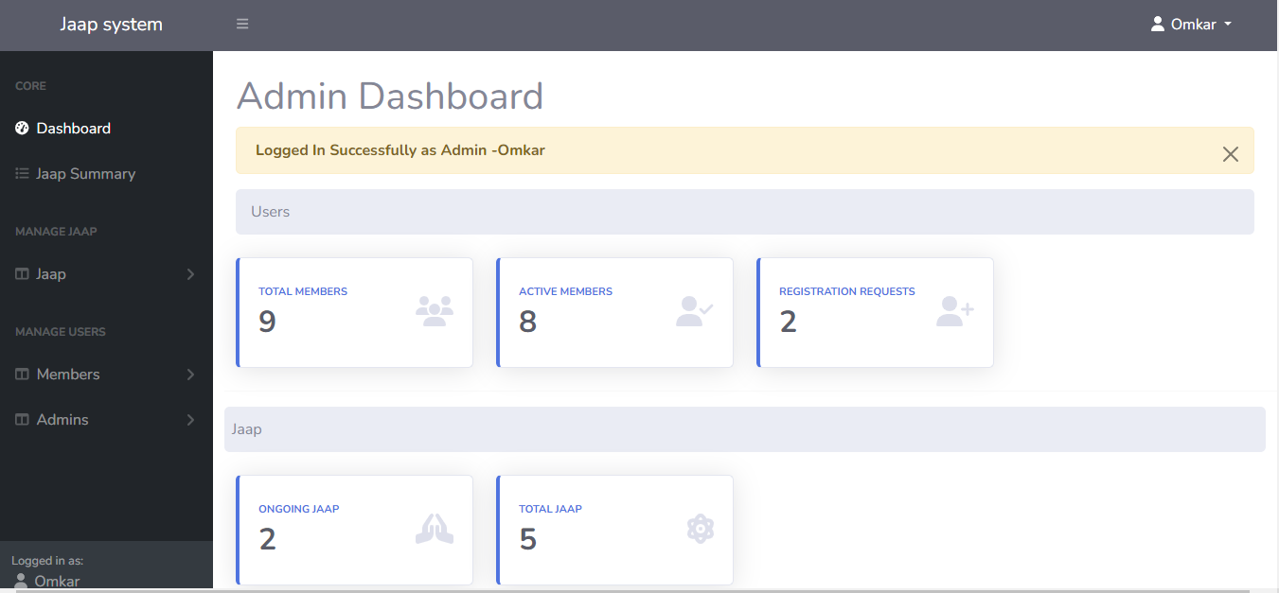
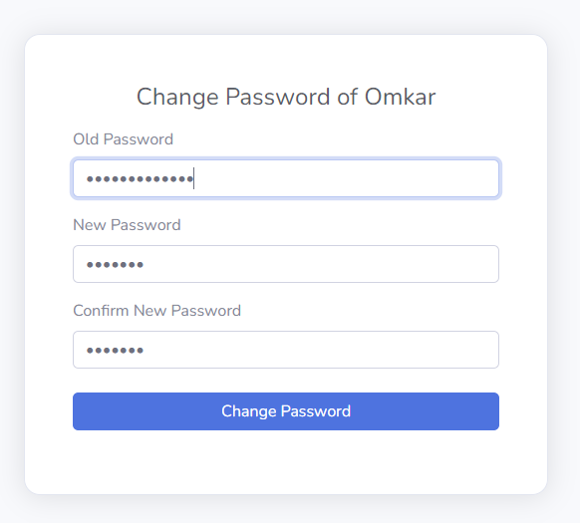
Change Password
Page
Dashboard Page

Slide 13
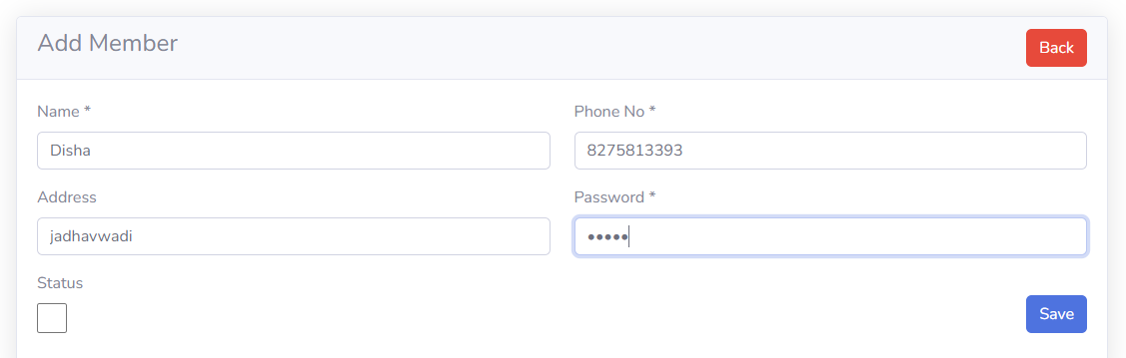
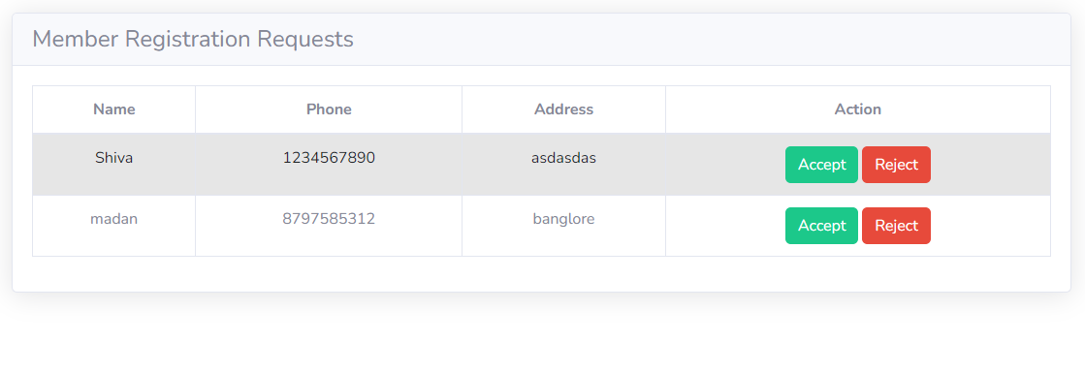
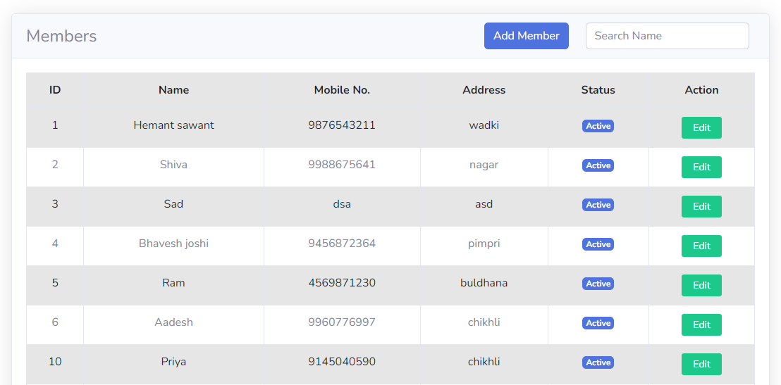
Add Member Page
Member Approval Page
View Member Page

Slide 14
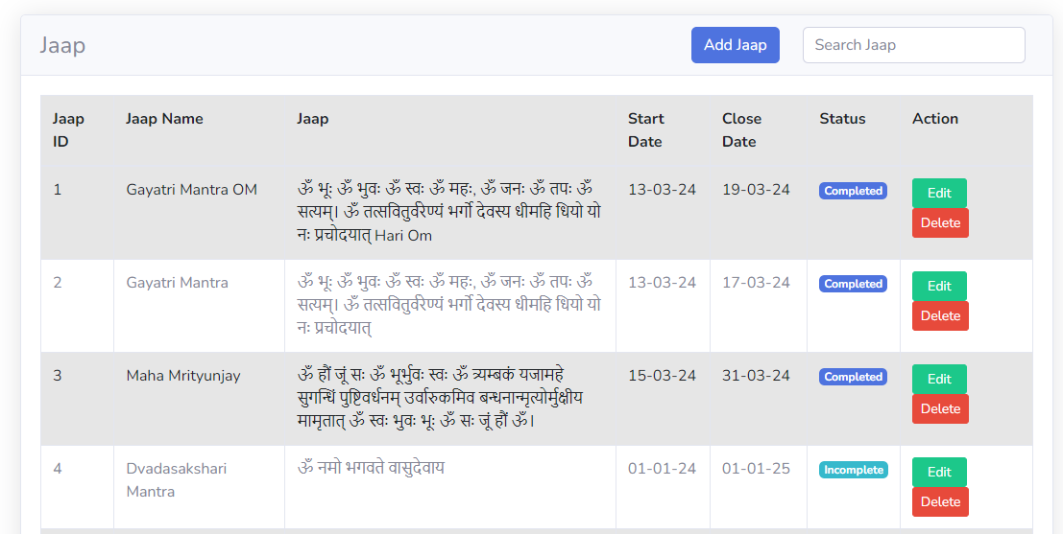
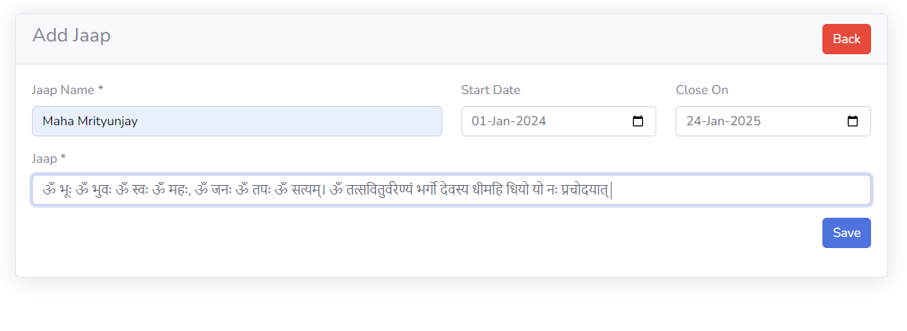
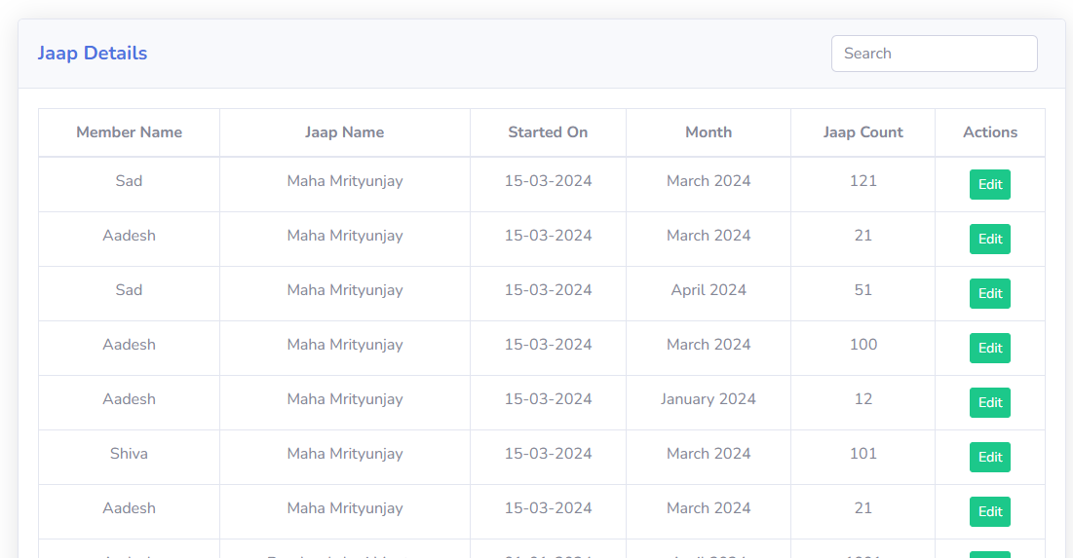
Add Jaap Page
View Jaaps Page
Jaap Count Page

Slide 15
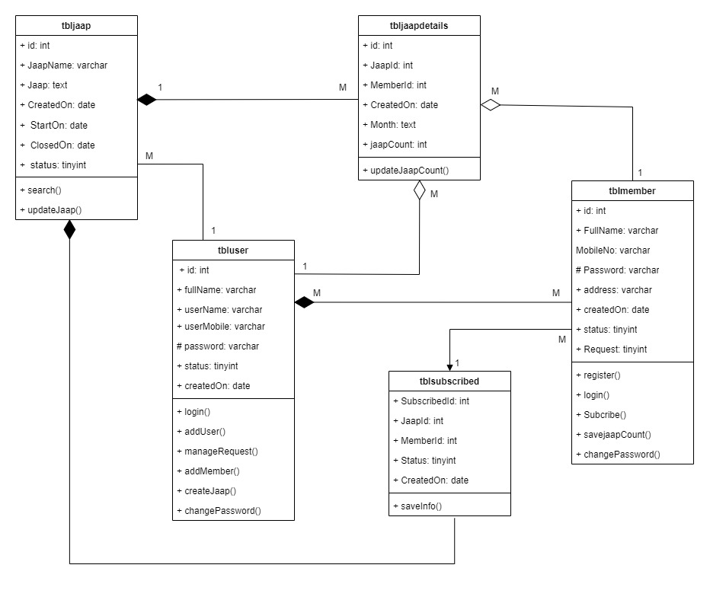
Class Diagram

Slide 16
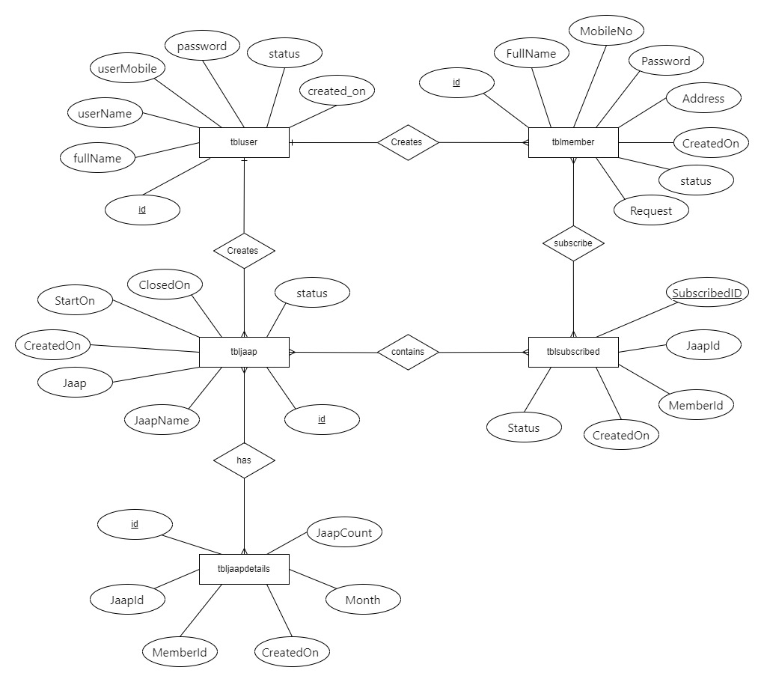
ER Diagram

Slide 17
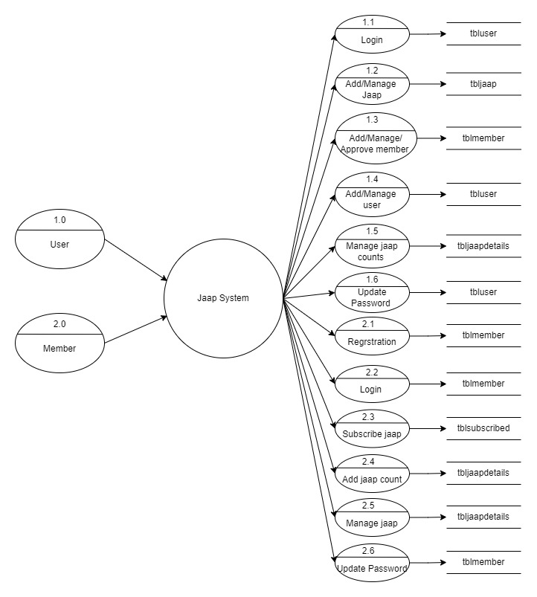
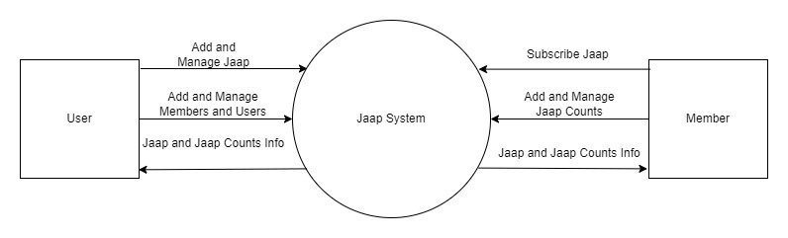
Data Flow Diagram
1st level DFD
Context level DFD

Slide 18
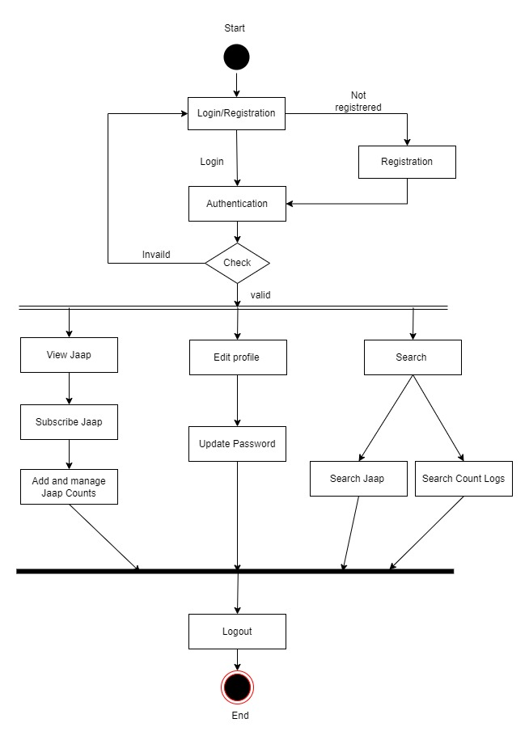
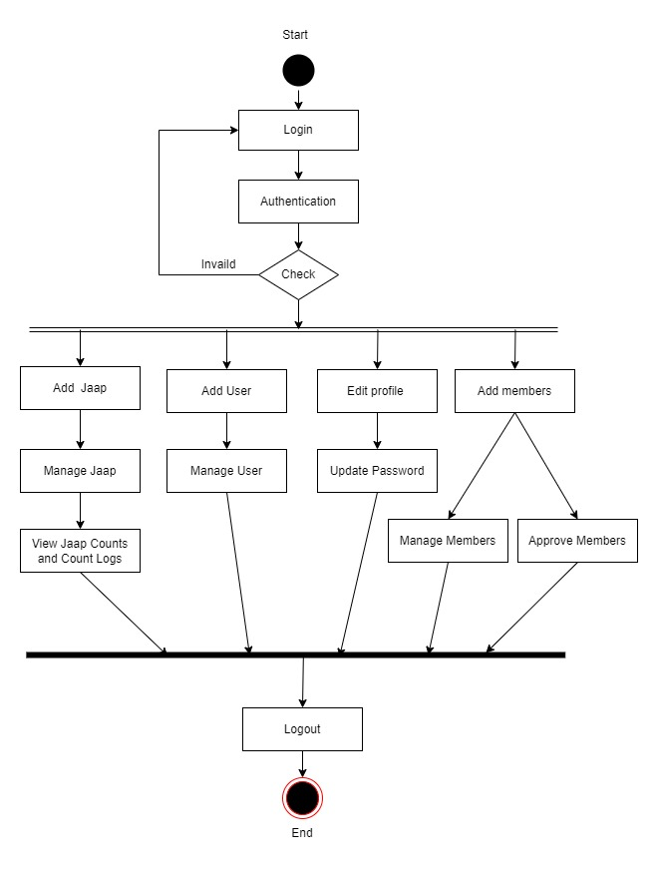
Activity Diagram
Members
Activity
Users
Activity

Slide 19
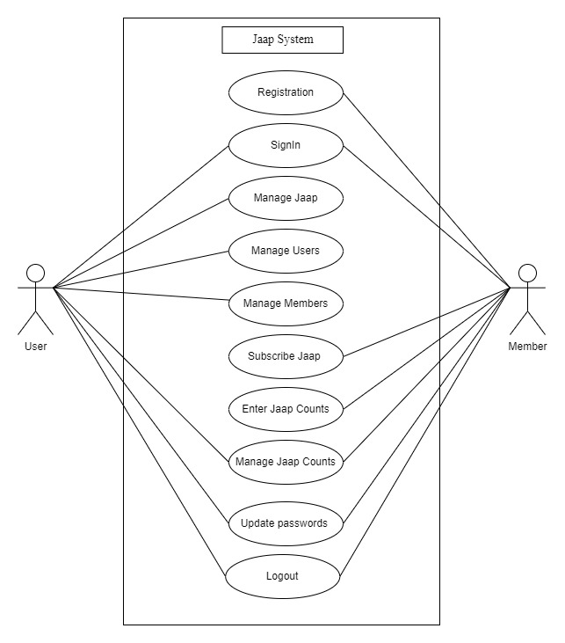
Use Case Diagram

Slide 20
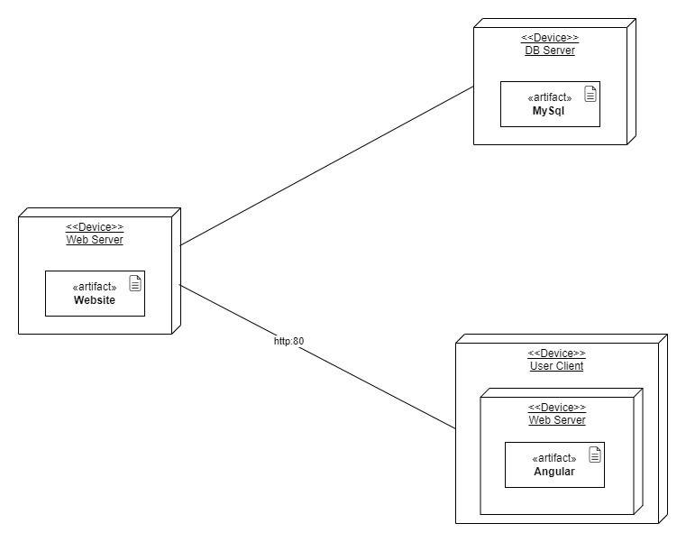
Deployment Diagram

Slide 21
Data dictionary
tbljaap
Field name | Data Type | Constraints | Description
id | Int(11) | Primary key | Unique id for Jaap
JaapName | varchar(255) | Not null | Name of jaap
Jaap | text | Not null | Jaap for chanting
CreatedOn | date | Not null | Date and time of jaap creation
StartOn | date | Null | Date of jaap to be started on
ClosedOn | date | Null | Date of jaap creation to be closed on
status | tinyint | Not null | Status of jaap: 0= incomplete,1= complete

Slide 22
Data dictionary
tbluser
Field name | Data Type | Constraints | Description
id | Int | Primary key | Unique id for Jaap
FullName | varchar(255) | Not null | Name of user
userName | varchar(255) | Not null | User name of an user
userMobile | varchar(255) | Not null | Phone no. of an user
password | varchar(255) | Not null | Password of user
status | Tinyint(4) | Not Null | Status of user: 0=active, 1=banned
created_on | date | Not Null | Date of user creation

Slide 23
Data dictionary
tblmember
Field name | Data Type | Constraints | Description
id | Int(11) | Primary key | Unique id for Jaap
FullName | varchar(150) | Not null | Name of member
MobileNo | varchar(50) | Not null | Phone no. of an member
Password | varchar(1000) | Not null | Password of member
Address | Text | Not null | Address of member
CreatedOn | date | Not Null | Date of member creation
status | Tinyint(1) | Not Null | Status of member: 0=active, 1=banned

Slide 24
Data dictionary
tbljaapdetails
Field name | Data Type | Constraints | Description
id | Int(11) | Primary key | Unique id of jaapdetails
JaapId | Int(11) | Foreign key | Unique id of Jaap
MemberId | Int(11) | Foreign key | Unique id of member
CreatedOn | date | Not null | Date of details created
Month | text | Not null | Name of Month for jaap count submitted
JaapCount | Int(11) | Not null | Number of jaap counts chanted.

Slide 25
Data dictionary
tblsubscribed
Field name | Data Type | Constraints | Description
SubscribedID | Int(11) | Primary key | Unique id of subscription
JaapId | Int(11) | Primary key | Unique id of Jaap
MemberId | Int(11) | Primary key | Unique id of member
CreatedOn | Datetime | Not null | Date of subscription done.
status | Tinyint(4) | Not null | Status of subscription : 0=Unsubscribe, 1=Subscribe

Slide 26
Drawback and limitations
1. Dependency on Technology: The Jaap Counter System relies heavily on technology and internet connectivity. Users in areas with limited access to technology or unstable internet connections may face challenges in accessing the system consistently.
2. Privacy Concerns: Storing personal spiritual practices and data online may raise privacy concerns for some users. Despite implementing security measures, there is always a risk of data breaches or unauthorized access, potentially compromising the privacy of users' spiritual practices.
3. User Adoption and Engagement: Encouraging users to adopt the system and maintain consistent engagement with their spiritual practices may be challenging. Some users may prefer traditional pen-and-paper methods or be hesitant to share their spiritual journey online due to privacy or cultural reasons.
4. Customization Complexity: While the system offers customization options for creating and managing jaaps, the process may be complex for members with limited technical proficiency. Simplifying the user interface and providing clear instructions may help mitigate this limitation.
5. Limited Personalization: Despite offering customization options, the system may not fully cater to the diverse
spiritual preferences and practices of all users. Some individuals may require additional
features or flexibility that the system does not currently provide.

Slide 27
Proposed Enhancement
Offline Functionality: Introducing offline capabilities, such as offline jaap count entry and synchronization, would improve accessibility and usability for users in areas with limited internet connectivity.
Customizable Privacy Settings: Implementing customizable privacy settings would allow users to control the visibility of their jaap counts and other personal information, addressing privacy concerns while maintaining a sense of community.
Integration with Wearable Devices: Integrating the system with wearable devices capable of tracking biometric data, such as heart rate variability, could provide users with additional insights into the physiological effects of their spiritual practices.
Enhanced Community Features: Expanding community features, such as forums, live events, and mentorship programs, would further foster a sense of belonging and support among users.
Advanced Analytics and Insights: Developing advanced analytics capabilities to provide users with personalized insights and recommendations based on their jaap practice and behavior patterns would enhance user engagement and satisfaction.

Slide 28
Conclusion
In conclusion, the Jaap Counter System represents a valuable tool for individuals seeking to integrate spiritual practices into their lives. By harnessing the power of technology, the system provides users with a convenient and accessible platform for chanting mantras or jaaps, tracking their progress, and engaging with a supportive community. While the system may have some limitations, such as dependency on technology and privacy concerns, future enhancements hold the promise of further improving its usability, effectiveness, and inclusivity. Overall, the Jaap Counter System stands as a testament to the transformative potential of combining ancient spiritual practices with modern technology to promote mental well-being and spiritual growth.

Slide 29

Thanks!

